Slide 1

Ashley Madison
by Steven Brannum

Slide 2
AshleyMadison.com
Online dating site marketed towards people that are in relationships.
Founded in 2002.
~46 Million Users as of 2016
Also runs HotOrNot.com

Slide 3
Business Problem
Sending messages or “gifts” require credits.
Credits are bought in increments of $50.
Ashley Madison’s Perspective:
Determine who is buying credits.

Slide 4
The Data
Relationship status
Smoking habits
Credits
Gender
Body Type
Bot chatted to you
Data is a snapshot in time
Data quality is poor
Self-reported data
Invalid entries
Lookie-Loos

Slide 5
Model 1 - Patterns
Males
99% of the people with credits were men.
Males with Credits
73% of the men with credits were hetero men in relationships.
No credits
100% confidence that a bot had not chatted with you
Females
99.9% confidence that a bot did not chat to you.

Slide 6
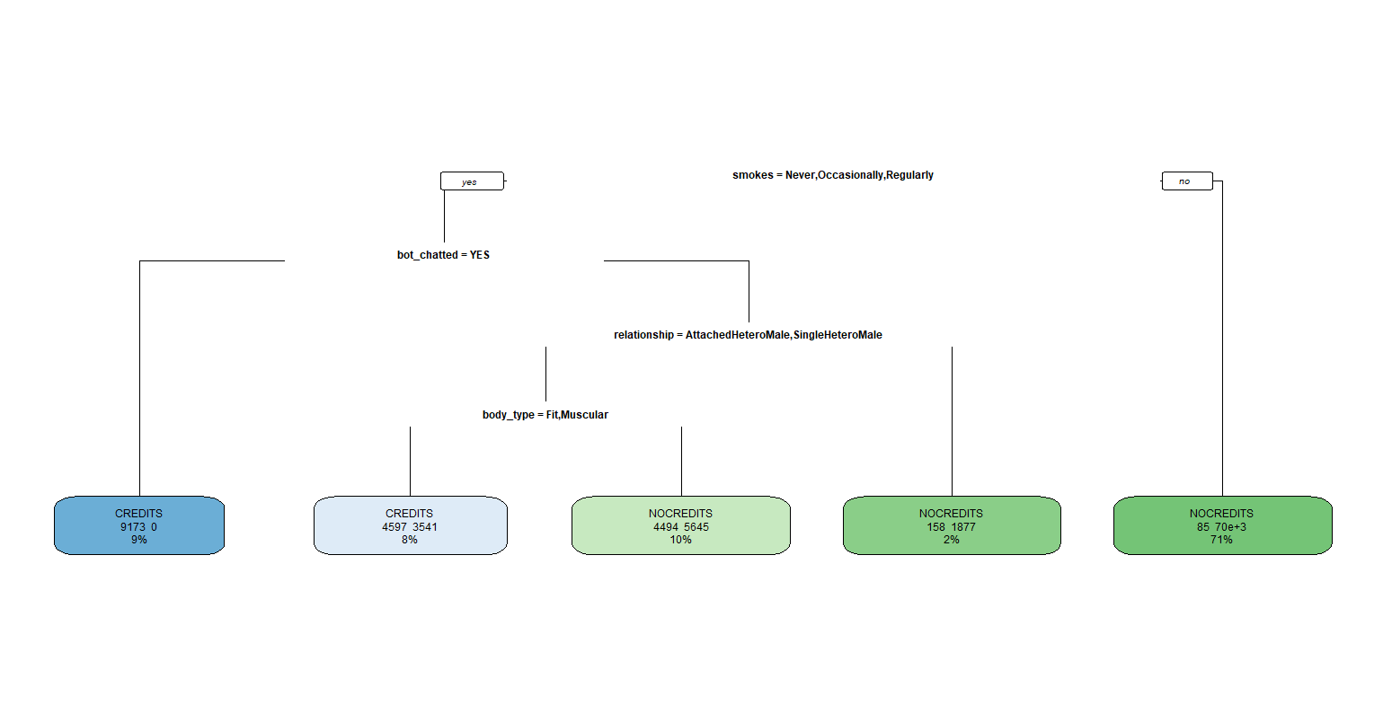
Model 2

Slide 7
Model 2
Filled out smoking section?
Bot chatted to user?
Credits:80
No Credits: 70k
Is heterosexual male?
Fit or Muscular?
Credits: 158
No Credits: 1877
Credits: 4597
No Credits: 3541
Credits: 4494
No Credits: 5845
Credits: 9173
No Credits: 0
Yes
No
Yes
No
Yes
No
Yes
No

Slide 8
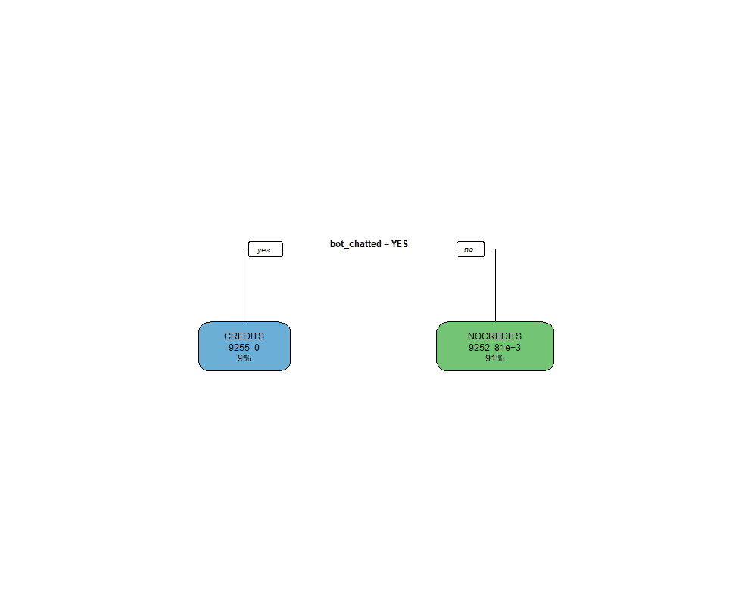

Slide 9
Bot chatted to user?
Credits:9252
No Credits: 81493
Credits: 9255
No Credits: 0
Yes
No

Slide 10
Conclusion
An event or crowd that promises to be full of attractive women, but turns out to be nothing but a bunch of desperate men.
allergic_to_myself, UrbanDictionary.com

